Slide 1
Python Dictionary
Pham Trung Kien

Slide 2
Agenda
What is python dictionary?
Definition
Key-value
Working with python dictionary
How to create a dictionary
Access elements from a dictionary
How to change or add elements in a dictionary
Deleting elements from a dictionary
Dictionary methods

Slide 3
Python dictionary
A type of built-in data structure in Python.
Python dictionary is an unordered collection of items.
Data stored in dictionary comes with key-value pairs not singly elements.
Key:
Each key is unique and connects to a value.
Key comes before value.
Used to access value associated with that key.
Value:
Can be access when key is known.
Can be duplicate among key-value pairs.
Value can be any type of object in python (int, float, list, dictionary, object, …)
A dictionary can store limitless amount of data.

Slide 4
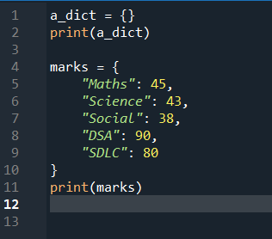
Creating a dictionary
Items inside a dictionary are placed in curly brackets {} and separated by comma
Value can be of any data types and duplicate
Keys must be of immutable data type and unique

Slide 5







Access values in dictionary
Dictionary uses keys to access values
Value can be access in two ways:
Direct: dict_name[key]
-> throw KeyError if key not found
Via method: dict_name.get(key)
-> return None if key not found

Slide 6
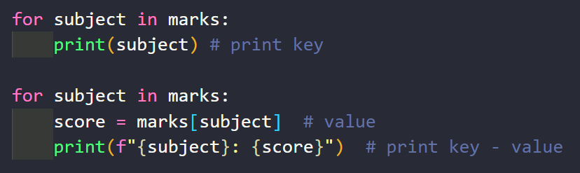
Access elements by iterating through a dictionary
Using a for loop we can iterate through each key in a dictionary

Slide 7
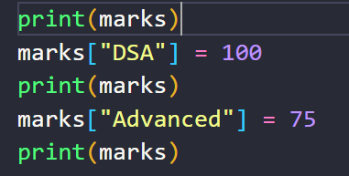
How to change or add elements in a dictionary
Dictionary is mutable. We can add new items or change the value of existing items using assignment operator.
If the key is already present, value gets updated, else a new key-value is add to the dictionary

Slide 8
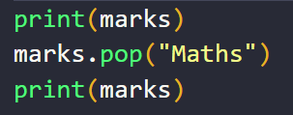
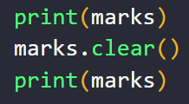
Deleting elements from a dictionary
We can remove a particular item in a dictionary by using the method pop(). This method removes as item with the provided key and returns the value.
All the items can be removed at once using the clear() method.
We can also use the del keyword to remove individual items or the entire dictionary itself

Slide 9
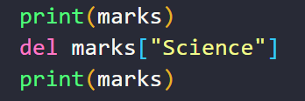
Deleting elements from a dictionary

Slide 10
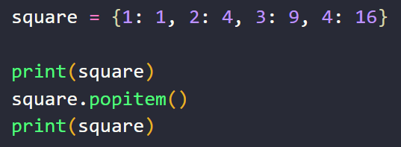

To delete random element
The method, popitem() can be used to remove and return an arbitrary item (key, value) form the dictionary
It raises the KeyError if the dictionary is empty

Slide 11
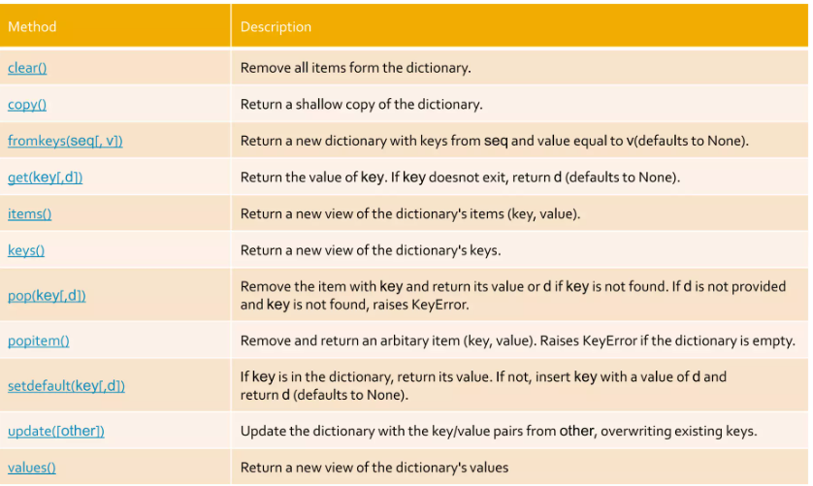
Python dictionary methods

Slide 12
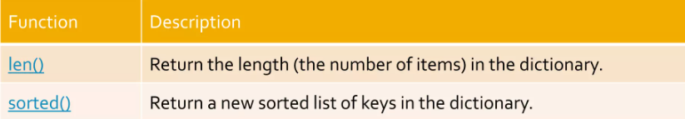


Built-in functions with Dictionary

Slide 13
Python Set
Pham Trung Kien

Slide 14
Agenda
What is python set?
Definition
Working with python set
How to create a set
Adding elements to set
Remove elements from a set
Python set operations
Set mutation operations

Slide 15
Python Sets
A set is an unordered collection of items. Every element is unique and must be immutable.
However, the set itself is mutable. We can add or remove items from it.
Sets can be used to perform mathematical set operations like union, intersection, symmetric difference, …

Slide 16
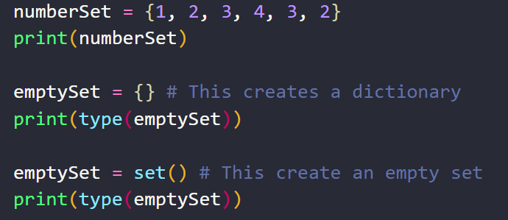

Creating a set
A set is created by placing all the elements inside curly braces {}, separated by comma or by using the built-in function set().
The elements can be of different types (integer, float, tuple, string, etc).
But a set cannot have a mutable element, like list, set or dictionary, as its element.

Slide 17
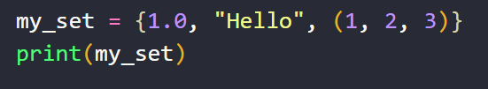
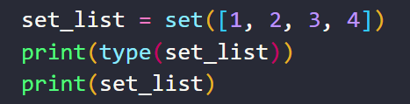




A set can contain elements of different type
List can be converted into Set using set() function
A set cannot contain lists

Slide 18
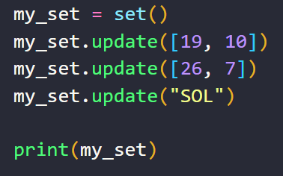
Adding elements to set
Sets are mutable. But since they are unordered, indexing have no meaning
We cannot access or change an element of set using indexing or slicing.
We can add single element using the add() method and multiple elements using the update() method.
The update() method can take tuples, lists, strings or other sets as its argument.
In all cases, duplicates are avoided.

Slide 19






Remove elements from a set
A particular item can be removed from set using methods, discard() and remove()
Using discard() if the item does not exist in the set, it remains unchanged.
But removed() will raise an error in such condition.

Slide 20
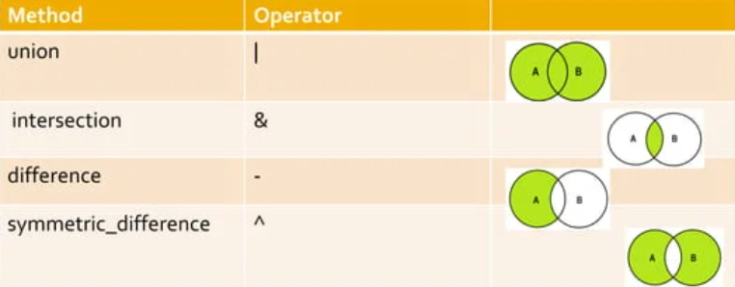
Python Set Operations
Sets can be used to carry out mathematical set operations like union, intersection, difference and symmetric difference.
We can do this with operators or methods

Slide 21
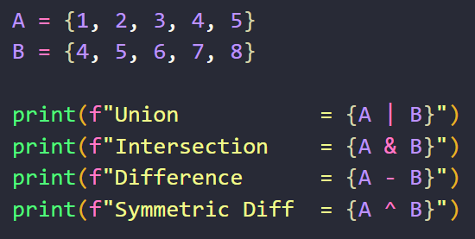
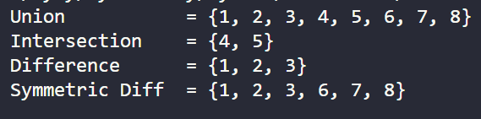

Slide 22
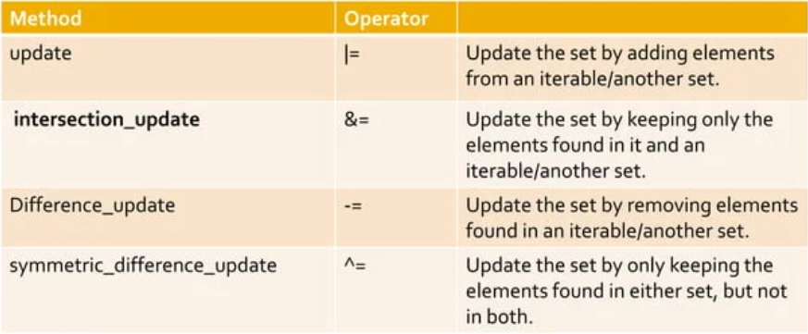
Set mutation operations
We have seen the applications of union, intersection, difference and symmetric difference operations, but these operations do not make any changes or mutations to the set.
We can use the following operations to create mutations to a set:

Slide 23
isdisjoint() – This method will return True if two set have a null intersection
issubset() – This method reports whether another set contains this set
issuperset() – This method will report whether this set contains another set

Slide 24
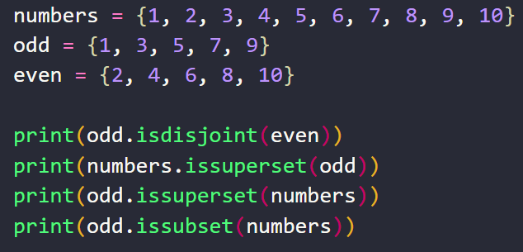

isdisjoint() – This method will return True if two set have a null intersection
issubset() – This method reports whether another set contains this set
issuperset() – This method will report whether this set contains another set

